Slide 1
BCIC Updates

Slide 2
Upcoming Events
Tomorrow
Representative Wendi Thomas Senior Expo
30 Apr.
Drug Take Back Day-Big Little Health will be giving vaccines
1 May
Hold on You Matter Walk
13 May
Sports Block Party
21 May
New Hope Celebrates Pride Day
25 May
Senior Games Kick Off
11 June
Warminster Day
18 June
Doylestown Pride Day

Slide 3
8 different events in the upcoming months as well as 2 immunization conferences
Just went to the PA Health Equity Conference in Pittsburgh
Pediatric Immunization packet Project where we went to every daycare in Bucks County giving out over 2000 packets has been completed and we are now doing Senior Immunization packets where we will head out to all senior living facilities in Bucks County
Heading out to physicians' offices to give out bags with materials for county clinics, homebound vaccines and other crucial information for patients. We have delivered over 80 packets so far
Continuing to collaborate with Big Little Health for homebound vaccinations as well as having them come out to give vaccines at events. We are also looking to provide street medicine where we physically go out on the streets to homeless population and give vaccines.
Collaborating with Walmart to increase awareness on homebound vaccinations by distributing our homebound flyer
BCIC and Big Little Health will be heading out to all senior living facilities in Bucks County to give COBID-19 vaccines
Maintaining accurate list of vaccine locations in Bucks County for Bucks County government websites
Continuing to produce the county vaccination data bi-weekly
Continue to run monthly calls with all 6 county hospitals to give updates on policy changes, covid-19 cases and any other important information
Maintaining all BCIC social media
Barriers: misinformation and covid fatigue

Slide 4
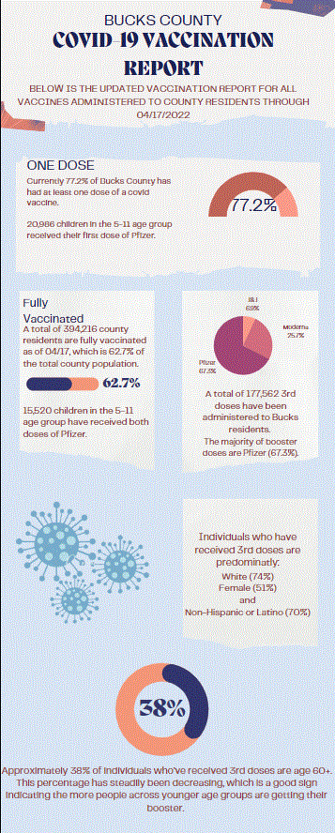
County Data for COVID-19 Vaccinations
BCIC has continued to produce the County Immunization Data bi-weekly:
As of April 17th, 484,992 Bucks residents have had at least one dose of a COVID vaccine. This is an increase of 2515 first doses from two weeks ago.
Currently 77.2% of the county has had at least one dose of a covid vaccine, and an estimated 88.90% of those age 12+ have had at least one dose.
As of 04/17, 20,968 children in the 5-11 age group have received their first pediatric dose of Pfizer. Within this group, 18,207 have received both doses of Pfizer.
We continue to see disparities in vaccination rates for Black, Asian, and Hispanic County residents.
A total of 394,296 county residents are fully vaccinated as of 04/17, which is 62.7% of the total county population, and 72.3% of the estimated population that is age 12+.
Just a reminder that county clinics are still open for walk-ins!

Slide 5
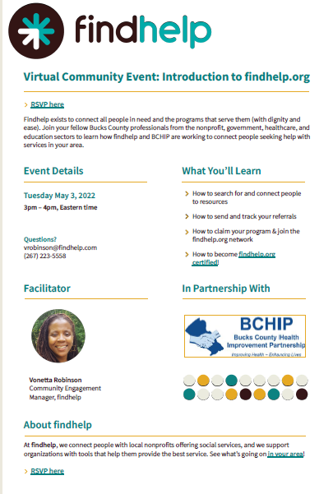
Findhelp.org training
Findhelp exists to connect all people in need and the programs that serve them (with dignity and ease)
Join your fellow Bucks County professionals from the nonprofit, government, healthcare, and education sectors to learn how findhelp and BCHIP are working to connect people seeking help with services in your area.
When: Tuesday May 3rd from 3pm-4pm
This will be sent out with the meeting minutes but if you have any questions, please reach out to Kim Everett at keverett@bchip.org

Slide 6
PAIC Updates we want to share!
PAAAP and PAIC Let’s Talk-National Infant Immunization Week Webinar on Friday, April 29th at 12pm
PAIC and PAAAP Digital Resources and Social Media Assets
We would like to start connecting and sharing social media so that we all have collaborative messaging throughout the community. Would you be willing to start sharing our messaging and sharing each others?
Pennsylvania Immunization Conference at the Hershey Lodge on Tuesday June 14th
We will be attending!
National Immunization Coalition Conference September 12th-15th
We will be attending!
PAIC has an amazing newsletter weekly that we will be forwarding out to all our members for resources and information that we know will help the community!

Slide 7
Thank you!
We thank you all so much for your continued collaboration!
Please feel free to ask any questions.

