Slide 1
Welcome Chester County Immunization Coalition!
July 19, 2018

Slide 2
Disease Investigation and Surveillance
Gianna Megaro, MPH

Slide 3
Disease Investigation and Surveillance
Certain infectious diseases are mandated to be reported to the local, state and federal level.
Approximately 78 reportable illness to CCHD
Ensures tracking and identification of disease occurrence and patterns.
Minimize spread of disease spread
Education
Conduct daily surveillance and analysis

Slide 4
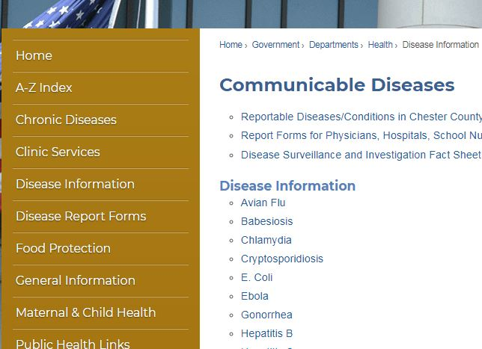
Sources of Reports
Electronic Reporting - PA NEDSS
National Electronic Disease Surveillance System
Phone Reports
Web-based Reports
www.chesco.org/health
Fax
Notes:
NEDSS
Improves timeliness, completeness, accuracy, uniformity
Secure communication between labs, hospitals, medical practices

Slide 5
2018 Hot Topics
Mumps Outbreak
39 reported cases of mumps 2/25/2018-7/1/2018
Hispanic population affected
Majority of cases were unimmunized or unaware of their immunization status
Initial transmission site
Baile Mexican Concert at the Chase Center in Wilmington, DE on 2/10/2018
Two additional outbreak settings at two mushroom farms in Chester County

Slide 6
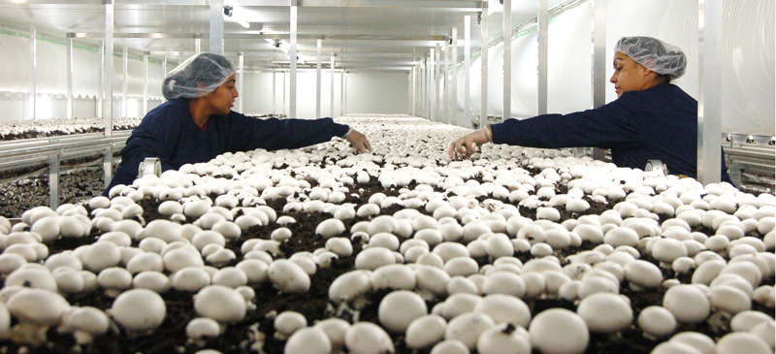
2018 Hot Topics
Mumps Outbreak Interventions
Vaccine clinics
Social media posts
Press release
Health alerts to healthcare facilities
School & workplace notifications
Challenges
Language
Education
Population
Healthcare facilities

Slide 7
2018 Hot Topics

Slide 8
Points of Dispensing (PODs)
Part of the Chester County Medical Countermeasures (MCM) Program
Purpose:
To dispense essential medication to all residents and visitors in Chester County in response to a public health emergency
School District Involvement
Each has at least 1 Open POD at a school (usually HS)
Trained to dispense medication to the public
Exercise dispensing (oral or vaccine simulation) with the County on a multi-year cycle
Good opportunity to train school staff and enhance preparedness for emergencies
For more information, contact Sarah Koeller at 610-344-6683

Slide 9
Questions?

Slide 10
Trivia Time!

Slide 11
Which disease is known to be more commonly spread from adults to children?
Varicella (chickenpox)
Pertussis (whooping cough)
Measles
Rubella
Notes:
B. Pertussis – Typically, children spread infections to adults; however, pertussis is more commonly spread from adults to children. For this reason, adults who are going to be around young infants are recommended to get one dose of Tdap vaccine. Protecting babies by immunizing those around them is known as cocooning.

Slide 12
In 1916, rumors circulated that candy was the cause of what infectious disease?
Measles
Smallpox
Polio
Influenza
Notes:
C. Polio – In 1916, rumors circulated that candy caused polio. Candy was also rumored as the cause of other infectious diseases, such as cerebrospinal meningitis. In fact, candy was so frequently blamed for poisonings and injuries that the National Confectioners Association thoroughly investigated almost every report on ‘candy poisonings.’ The investigators found that out of the hundreds of reports of candy poisonings, very few were based on facts.

Slide 13
TB, STI, HIV
Maureen Gallagher, RN, MSN
Notes:
Why do we have these programs? REPORTABLE DISEASES

Slide 14
What do you know about TB?
It’s an ancient disease
There was a resurgence in the early/mid 1990’s
It’s only a plane ride away!
Notes:
AKA consumption; send people to sanatoriums

Slide 15
What’s the Global Impact of TB?
24, 000 new case of TB/day
8,000 cases missed/day
4,000 people die of TB/day
1,315 new drug resistant TB cases/day
219 children who die of TB/day
10.4 million people develop active TB each year
4.3 million people are “missed” each year
1/3 of the World’s population is infected with TB
480,000 multi-drug resistant cases
Notes:
Infection----the goal of the CDC is to identify and treat this population before they develop active TB

Slide 16
What’s the Local Impact of TB?
2018 YTD data
9 suspect/active cases in CC
2017 data: 9093 cases in the U.S.
192 cases in PA
10 cases in Chester County
2016 data: 9287 cases in the U.S.
173 cases in PA
4 cases in Chester County
Notes:
Suspect cases---following lab reports, assessing the individual’s circumstances, awaiting cultures

Slide 17
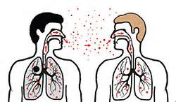
TB Exposure, Infection and Disease
How is TB spread?
Droplet spread through the air
Coughing
Sneezing
Talking
Singing
Active vs. Infection
Testing
Skin test vs. Blood Test
Treatment
No infection
Infected, but not sick
Active infection (SICK)
Notes:
After Tuberculosis Exposure, one of three things will happen:
1. Even though exposed to TB, the person will have no evidence of Tuberculosis
The person’s lungs will be infected with TB bacilli, the body will mount an immune response and contain the infection. NO symptoms, but at risk of progressing to TB at a later date
The immune system is overwhelmed by the TB and person becomes sick with tuberculosis.
So how can we distinguish between persons with no infection, those that are infected but not sick and those that are sick with TB?

Slide 18
TB Testing
Should employ risk-based screening
Identify those exposed and infected but NOT sick (Latent)
To Test is To Treat
Evaluate for suspected TB disease (Sick/Active)
Use the correct test
PPD
IGRA
Notes:
Tuberculosis testing is a helpful tool to identify active TB cases, those that are at risk for disease and those who are not infected.
Tuberculosis testing is used only to confirm infection with TB Bacilli, it can’t diagnose active Tuberculosis disease. However it can be useful with other tests in the evaluation of prolonged cough.

Slide 19
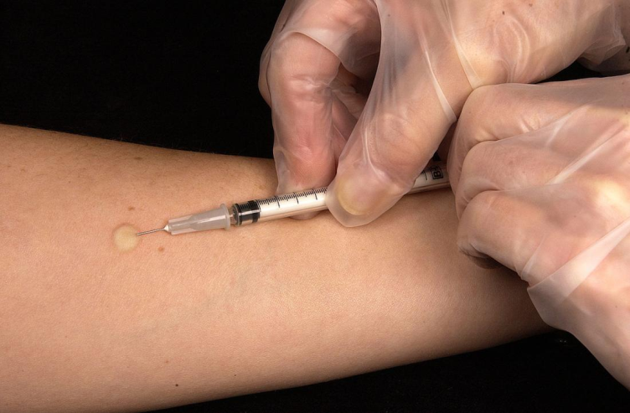
TB Testing-PPD Skin Tests
Administration
Live Vaccines
Return in 48-72 for interpretation
Notes:
PPD stands for “purified protein derivative”. It is an indication of the body’s immune response to TB. PPD interpretation is complicated. Before administering ask if the patient has ever had a PPD before, if so, did they have a reaction. Also, please verify that they have not received a live virus (FluMist, MMR, Varivax, Zostavax) in the past 4 weeks. It’s OK to place a PPD simultaneous to a live vaccine.
To administer a PPD:
AVOID SKIN OVER A VEIN, TATTOO OR ABRASIONS
BEFORE INSERTING NEEDLE, STRETCH SKIN TAUT BETWEEN THUMB AND FOREFINGER
HOLDING SYRINGE PARALLEL TO SKIN WITH BEVEL FACING UPWARD, INSERT AT 5-15 DEGREE ANGLE AND INSERT ALL OF THE SOLUTION
IF MINOR BLEEDING, DAB WITH COTTON SWAB- DO NOT COVER WITH BANDAGE OR APPLY PRESSURE
INSTRUCT NOT TO SCRATCH SITE- USE COOL COMPRESSES TO RELIEVE ITCHING OR SWELLING

Slide 20
TB Testing-PPD Skin Tests
Notes:
PALPATE AREA GENTLY TO DETERMINE PRESENCE OF INDURATION
MEASURE INDURATION(HARD BUMP WITH DISTINCT EDGES) AND NOT ERYTHEMA
MEASURE DIAMETER OF INDURATION PERPENDICULAR TO THE LONG AXIS OF THE ARM
USE A PEN TO MARK THE EDGES OF INDURATION
USE TUBERCULIN TESTING RULER TO MEASURE DISTANCE BETWEEN TWO POINTS

Slide 21
TB Testing-PPD Skin Tests
Positive PPD
>5mm High Risk Populations
>10mm Medium Risk Populations
>15mm Low Risk Populations
ONE and done
Notes:
> 5mm considered positive in high risk individuals
HIV infected persons
Recent contacts of active TB
People with fibrotic changes on chest x-ray consistent with TB
Patients with organ transplants and other immunosuppressed patients (15mg or more of prednisone for 1 month or more or take TNF-a antagonists)
>= 10 mm considered positive in moderate risk individuals
Recent arrivals to US (within last 5 years) from high prevalence areas
Residents or employees of high risk congregate settings (correctional facilities, hospitals, health care facilities, residential facilities for patients with HIV infection/AIDS, and homeless shelters)
Mycobacteriology laboratory personnel
Persons with clinical conditions that increase the risk for progression to TB disease
Children younger than 5 years of age- infants, children, and adolescents exposed to adults in high risk categories
> 15mm considered positive in individuals with no known risk factors for TB (generally should not be tested)

Slide 22
TB Testing-IGRAs
2 Types-
T spot
QFT-GIT(plus)
High specificity and operational advantages*
Immunosuppressed patients
Immigrants, regardless of time living in the US
Contacts
THE test of choice in those who received BCG
Notes:
Evaluated in CDC defined risk groups; shown to be cost effective

Slide 23
TST vs IGRA
ANY Mycobacterium vs specific for MTB
2 visits vs 1 visit
Technique vs Venipuncture
Subjectivity vs quantitative results
Consequences:
Unnecessary CXRs
Overtreatment TBI

Slide 24
What does CCHD TB Control Program look like?
Referral based
Open to CC residents only
Evaluation and Treatment at No Charge
New treatment modalities
DOT vs. eDOT
Why DOT?
Offer 4 clinics
Professional consultation
Educational outreaches
DON’T ever hesitate to call with questions.
Notes:
DOT---is the CDC’s standard of care
up to 12 pills for pansensitive; prevent drug resistance

Slide 25
US Impact of STIs
Chlamydia---4.7% increase since 2015
Gonorrhea---18.5 % increase since 2015
Syphilis
Primary and Secondary 17.6% increase since 2015
Congenital Syphilis---27.6% increase since 2015

Slide 26
Local Impact of STIs
2016 data(excludes Philadelphia)
Rates for ALL STIs are increasing
GC
195 cases in CC
6,954 cases in PA
44% 15-24 yrs. of age
CT
1134 cases in CC
34,060 in PA
68% 15-24 yrs. of age

Slide 27
Local Impact of STIs
Syphilis*
16 cases Primary & Secondary in CC
269 cases in PA
33% 15-29 yrs. of age
2017 CCHD 2018 CCHD YTD
CT 72 - CT 40
GC 20 - GC 12
Syphilis ???
HIV 3
Notes:
*COMPLEX

Slide 28
Consequences of Untreated STIs
PID
Inflammation of urethra, epididymitis, prostrate
Infertility---men and women
Premature labor
Miscarriage
Increased risk of HIV

Slide 29
STI/HIV Clinical Services:
CCHD’s clinic offers:
Confidential testing and treatment for individuals and partner(s)
CT, GC, Syphilis, HIV
Treat CT, GC, Syphilis
Treatments
Refer and link to care for HIV
Test based on a risk assessment
Urine
Swabs
Blood
14 years and up
NO charge
NO residency requirement

Slide 30
Questions?

Slide 31
Trivia Time!

Slide 32
Which president contracted smallpox a short time before delivering a famous speech?
George Washington
Abraham Lincoln
Grover Cleveland
Thomas Jefferson
Notes:
B. Abraham Lincoln became ill with smallpox a few days before delivering the Gettysburg Address. Current research suggests that the severity of Lincoln’s illness was downplayed by his doctor to prevent the public from worrying that their president was dying.

Slide 33
Out of every 100 people who get shingles, how many will get it again?
0
5
10
20
Notes:
B. Five of every 100 people who get shingles will get it for a second time. this is why even people over 20 who’ve had shingles are still recommended to get the shingles vaccine.

Slide 34
Maternal Child Health Services and Trends
Patricia Yoder, RN, MSN

Slide 35
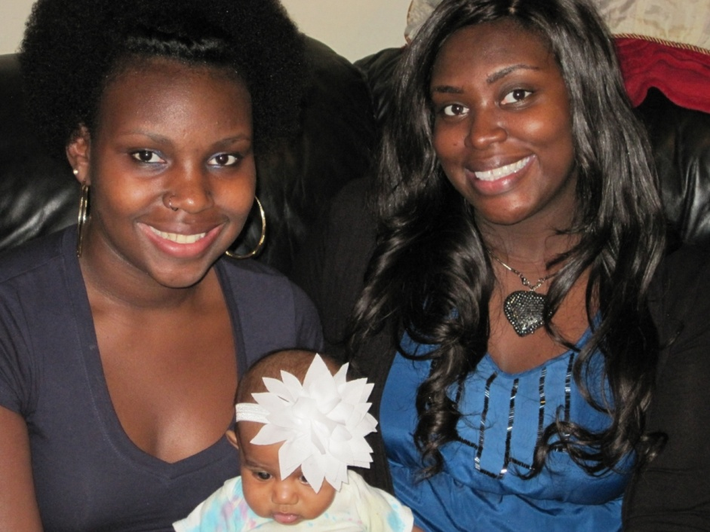
Home Visiting Services
History of MCH home visiting at CCHD
Title V
Nurse-Family Partnership
MIECHV

Slide 36
Referrals
Adolescent pregnancy/parent
At risk for preterm delivery
Special prenatal health concerns
Psychosocial issues (drug/alcohol abuse, domestic violence, depression, etc.)
Infant bonding/parenting concerns
Infant with special health needs

Slide 37
Community Partners
Prenatal Care Providers
Healthy Start/Family Center
School Nurses
CCIU/Young Parents Program
Crisis Pregnancy Centers
CC Dept. of Drug & Alcohol
Early Intervention; CYF
Community funders

Slide 38
CCHD Collaboration
WIC
Immunizations
Cribs for Kids
TB
STD/HIV
Lead/Healthy Homes

Slide 39
Early Childhood Trends
Evidence-Based Programming
Early Brain Development
Social-Emotional Health
Life Course Perspective
Toxic Stress/ACE’s
Trauma-informed Practice
Resilience/Protective Factors
Strengthening Families Framework
Two Generation Approach
Motivational Interviewing

Slide 40
What is a Two-Generation Approach?
Two-generation approaches provide opportunities for and meet the needs of vulnerable children and their parents together.

Slide 41
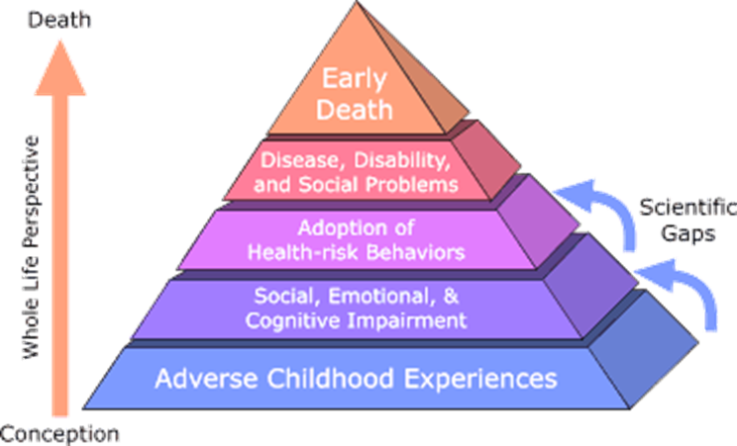
What are Adverse Childhood Experiences (ACE)?
Notes:
Because of this knowledge, the ACE Study was designed to assess what we considered to be “scientific gaps” about the origins of risk factors. These gaps are depicted as the two arrows linking Adverse Childhood Experiences to risk factors that lead to the health and social consequences higher up the pyramid. Specifically, the study was designed to provide data that would help answer the question: “If risk factors for disease, disability, and early mortality are not randomly distributed, what influences precede the adoption or development of them?” By providing information to answer this question, we hoped to provide scientific information that would be useful for developing new and more effective prevention programs.

Slide 42
What are Adverse Childhood Experiences (ACE)?

Slide 43
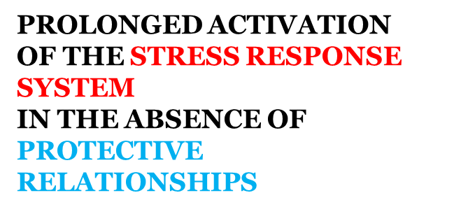
What are Adverse Childhood Experiences (ACE)?

Slide 44
Two Strategies for the Prevention of Toxic Stress

Slide 45
Positive CCHD Outcomes
Fewer preterm and low birthweight infants
Increased breastfeeding
Positive school retention
Decreased accidental injuries & ingestions
Prevention of child abuse

Slide 46
Evidence-Based NFP Outcomes
48% reduction in child abuse and neglect
56% reduction in ER visits for accidents and poisonings
67% reduction in behavioral and intellectual problems in children at age 6
59% reduction in arrest of children at age 15
72% fewer conviction of mothers when child is 15
$5.70 return per dollar in investment (RAND corporation study)

Slide 47
Mother-Child Connection
“I truly believe you have made me the mother I am today.”

Slide 48
Questions?

Slide 49
Trivia Time!

Slide 50
Although he died well before the vaccine was invested, Lewis Carroll, author of Alice in Wonderland, died from what vaccine-preventable disease?
Smallpox
Shingles
Polio
Influenza
Notes:
D. Influenza – Lewis Carroll wrote many stories but is probably the most famous for writing Alice in Wonderland and Through the Looking Glass. Lewis Carroll died from influenza in 1898.

Slide 51
While most vaccines are not given to pregnant women, which vaccines are recommended to pregnant women?
Hepatitis A and HPV vaccines
Rotavirus and hepatitis B vaccines
Influenza and pertussis vaccines
HPV and MMR vaccines
Notes:
C. Influenza and pertussis vaccines – The influenza vaccine is recommended for pregnant women because they have an increased risk of suffering complications if infected with influenza during their pregnancy. Pregnant women are also recommended to receive a dose of Tdap between 27 and 36 weeks’ gestation to protect both themselves and their newborns from pertussis.

Slide 52
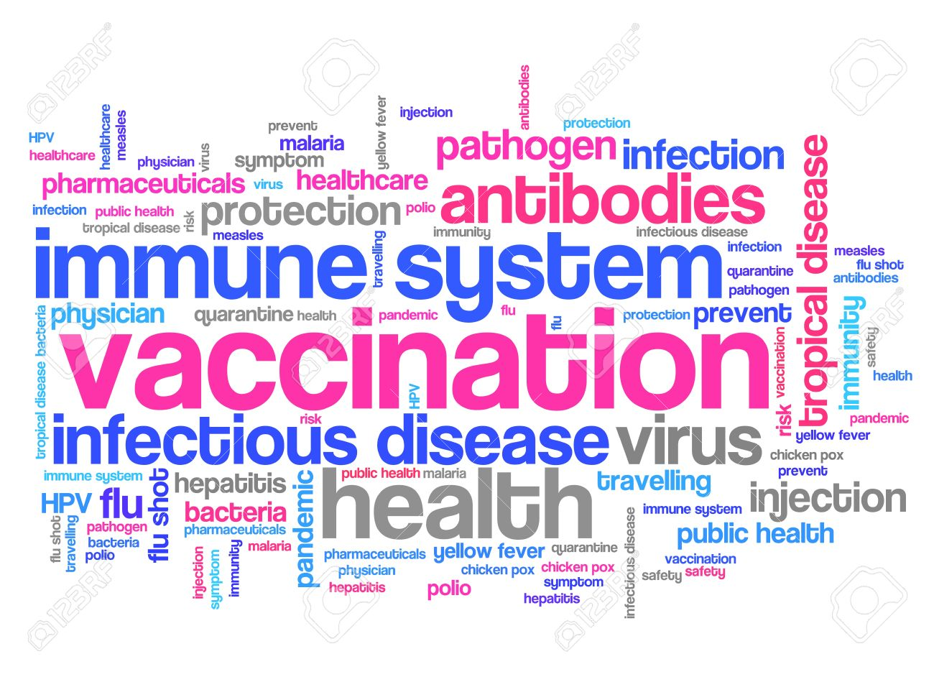
Immunization Program
Michele Steiner, MPH, RN

Slide 53
Immunization Clinic Services
Offer all CDC-recommended vaccines (not just school-required) to children and adults in language they can understand
Screen and test for TB
Capillary lead testing for uninsured children 1-5 yrs.
Offer community resources, including referral to MCHC for insurance navigation
www.chesco.org/health or call 610-344-6467

Slide 54
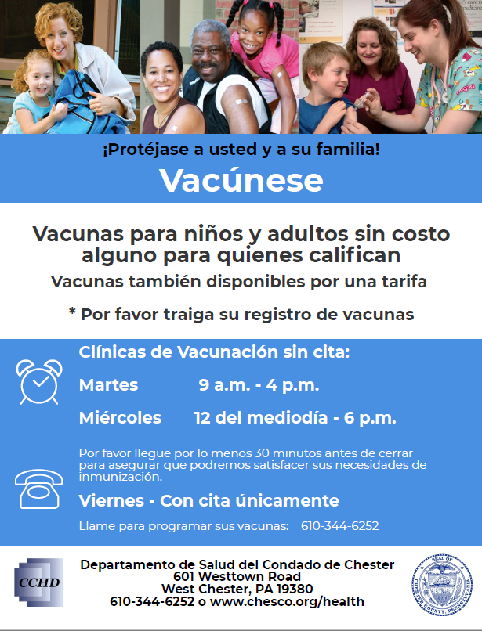

Slide 55
How Can School Nurses Help Us Help Patients?
Sign up for PA SIIS – www.health.pa.gov/MyRecords

Slide 56
How Can School Nurses Help Us Help Patients?
Send a legible copy of vaccine records with parents
Offer messaging that promotes the entire recommended vaccine schedule, not just school-required vaccines
Read email updates from CC School Nurse President
Champion vaccines to everyone you know!

Slide 57
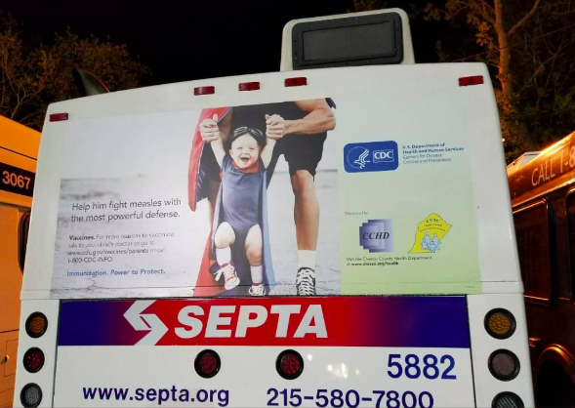
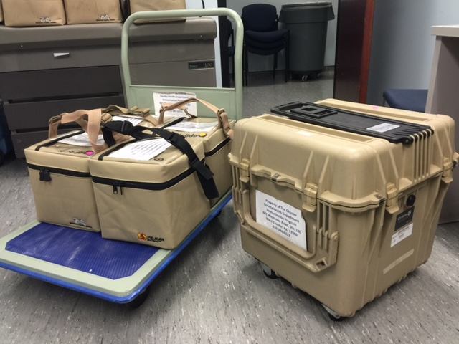
Vaccine Education and Outreach
Trusted resource for vaccine information
Audit school vaccine records
School Flu Vaccine Programs since 2006

Slide 58
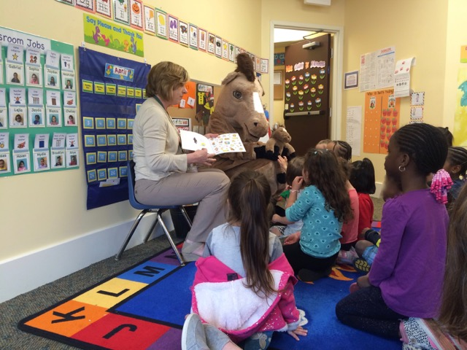
Chester County Immunization Coalition
All are welcome to bi-monthly meetings – 3rd Thursday
Annual professional education dinner in September
Subcommittees for special projects
Your ideas and input are valuable!

Slide 59
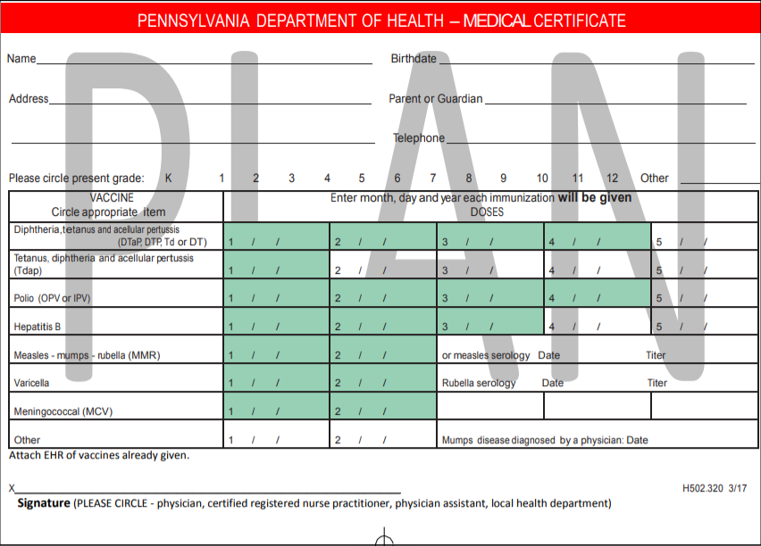
What’s New?
The Health Department is celebrating 50 years!
Tdap recommendation for adolescents
Medical Certificate
Clinic updates

Slide 60
Questions?
Contact: Michele Steiner
Immunization Program Coordinator
msteiner@chesco.org
610-344-6467

Slide 61
Questions?

Slide 62
Trivia Time!

Slide 63
Who is considered to be immune to measles, mumps and rubella, and are therefore not required to get the MMR vaccine?
Adults born before 1985
Adults born before 1957
Adults born between 1958 and 1965
Adults born between 1970 and 1985
Notes:
B. Adults born before 1957 – are not required to get the MMR vaccine because these diseases were so common that virtually everyone was exposed to the viruses and generated immunity naturally.

Slide 64
What vaccine-preventable disease used to be referred to as “the strangling angel of children?”
Diphtheria
Smallpox
Pertussis
Chickenpox
Notes:
A. Diphtheria – Diphtheria was called the “strangling angel of children because” of the thick membrane that develop in the back of the throat, often covering airways and causing suffocation.

Slide 65
Thank you!

