Slide 1
The Pennsylvania Immunization Coalition’s Advocacy Toolkit
How you can get your coalition involved in state advocacy.

Slide 2
Contacting Your Legislator
In order to get your coalition involved with local advocacy, first you must learn who your legislator is for your county.
You can identify your legislator here: https://www.legis.state.pa.us/cfdocs/legis/home/findyourlegislator/

Slide 3
Introduction
In the same email as this toolkit is an introductory letter to send to your legislator on behalf of your coalition.
Fill in the information and key points you want your legislator to know about your organization so they can understand the work you do.
Pair the correspondence with 3-4 pieces of literature that are a mix of work the coalition does along with general vaccine information.
Identify common interests and ways in which your coalition and legislator can help each other or identify mutually beneficial interests.

Slide 4
Contact The Office
Contacting your legislator’s staff is key to establishing a dialog.
Calling your legislator’s office number will most likely put you in contact with their staff, who can help you arrange a meeting.
Remain respectful, professional, and on topic.

Slide 5
The Meeting
Come prepared when you meet your legislator and his/her staff.
Create a list of 3-5 points which are important to your coalition’s goals.
Bring fact sheets, data tables, and any other visuals which will help support your points.
Stay on topic and respectful.
Your primary goal for this meeting is to establish a link for your coalition and you personally to be viewed as reliable, informed, a good listener, and eager to work together.
Some ideas to bring up could include:
Discussing current vaccine preventable disease status in the legislator’s county and in PA.
Identifying local resources such as free influenza vaccine clinics.

Slide 6
Letter Campaign
Ask your coalition members to participate in a letter writing campaign on a particular issue.
Offer a sample letter or outline from which members can work to create their own legislator letters. This gives your legislature a clear message from the coalition while retaining each individual’s unique perspective.
Use clear, precise language so your legislator understands your position.
Refer to specific house bills, legislation, or political actions in your letters.
Always ask your legislator for assistance or some action.
Follow up your letters with phone calls to show these issues are important to the coalition.

Slide 7
Literature
If your legislator is willing, send them literature he/she could display in their office.
This will allow them to give information to their constituents from your coalition directly.
If people have questions, your coalition’s contact information can be printed on the literature so he/she can get in touch with you directly.

Slide 8
Literature examples
Poster developed by the PA Chapter, American Academy of Pediatrics. File available from paaap@paaap.org.
Poster developed By the Center For Disease Control, CDC. File available from ncirdwebteam@cdc.gov

Slide 9
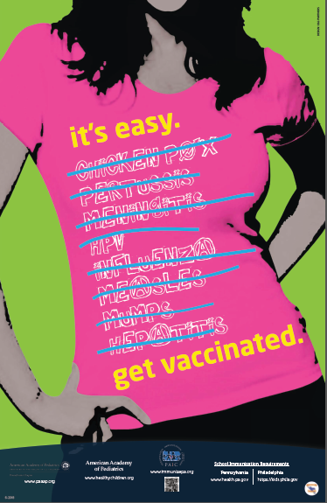
Examples of Literature on PAIC’s Website
https://www.immunizepa.org/wp-content/uploads/PAIC-8.5x11-Middle-School-Poster-2017.pdf
https://www.immunizepa.org/wp-content/uploads/infographic-702-2017-VFC.jpg
https://www.immunizepa.org/wp-content/uploads/Kids-Around-World-ENG-2018.pdf
https://www.immunizepa.org/wp-content/uploads/Female-Poster-ENG-2018.pdf
poster developed by the PA Chapter, American Academy of Pediatrics. File available from paaap@paaap.org.

Slide 10
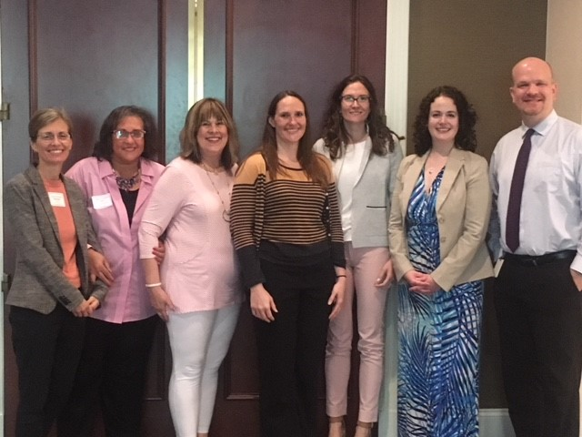
Invite
Invite your legislator to events your coalition plans on holding.
Legislators are busy people and need Be sure to inform them of the time, date, and place of the event well in advance.
Make sure someone from your coalition is assigned the task of greeting the legislator, introducing him/her, and thanking the legislator.
As a non profit it is important to inform legislators of our work, but not campaign or show favoritism to remain non profit.
We must allow all candidates the opportunity to participate at events
PAIC Board members at the Summer Immunization Conference in Harrisburg

Slide 11
Inform
Inform the Pennsylvania Immunization Coalition (PAIC) about your actions and the results so we can share your experiences with other local coalitions. We can all learn from each other!
Timely and frequent updates will help us move forward!

